Slide 1

Session 4b MSPglobal
Cross-sector and LME transboundary integration in MSP
Alejandro Iglesias Campos
Programme Specialist, Marine Policy and Regional Coordination Section
IOC-UNESCO
Marina Marković
Programme Officer
PAP-RAC
With the support of the:

Slide 2
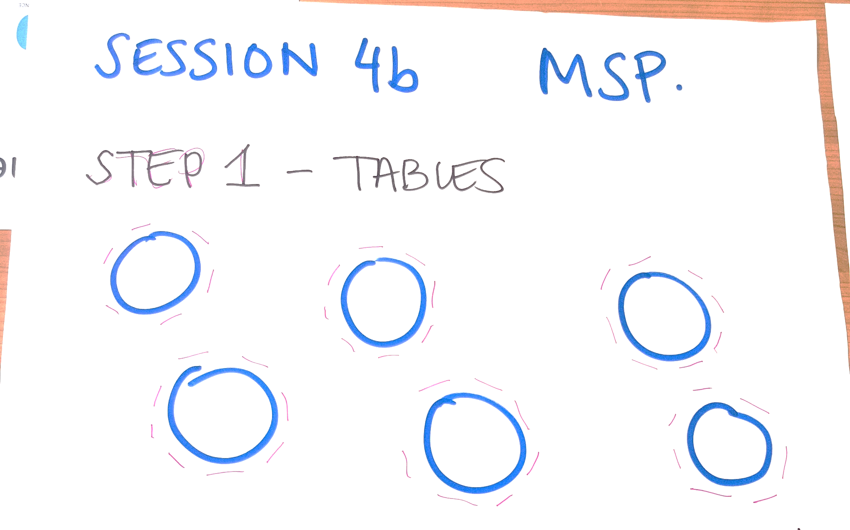

Slide 3
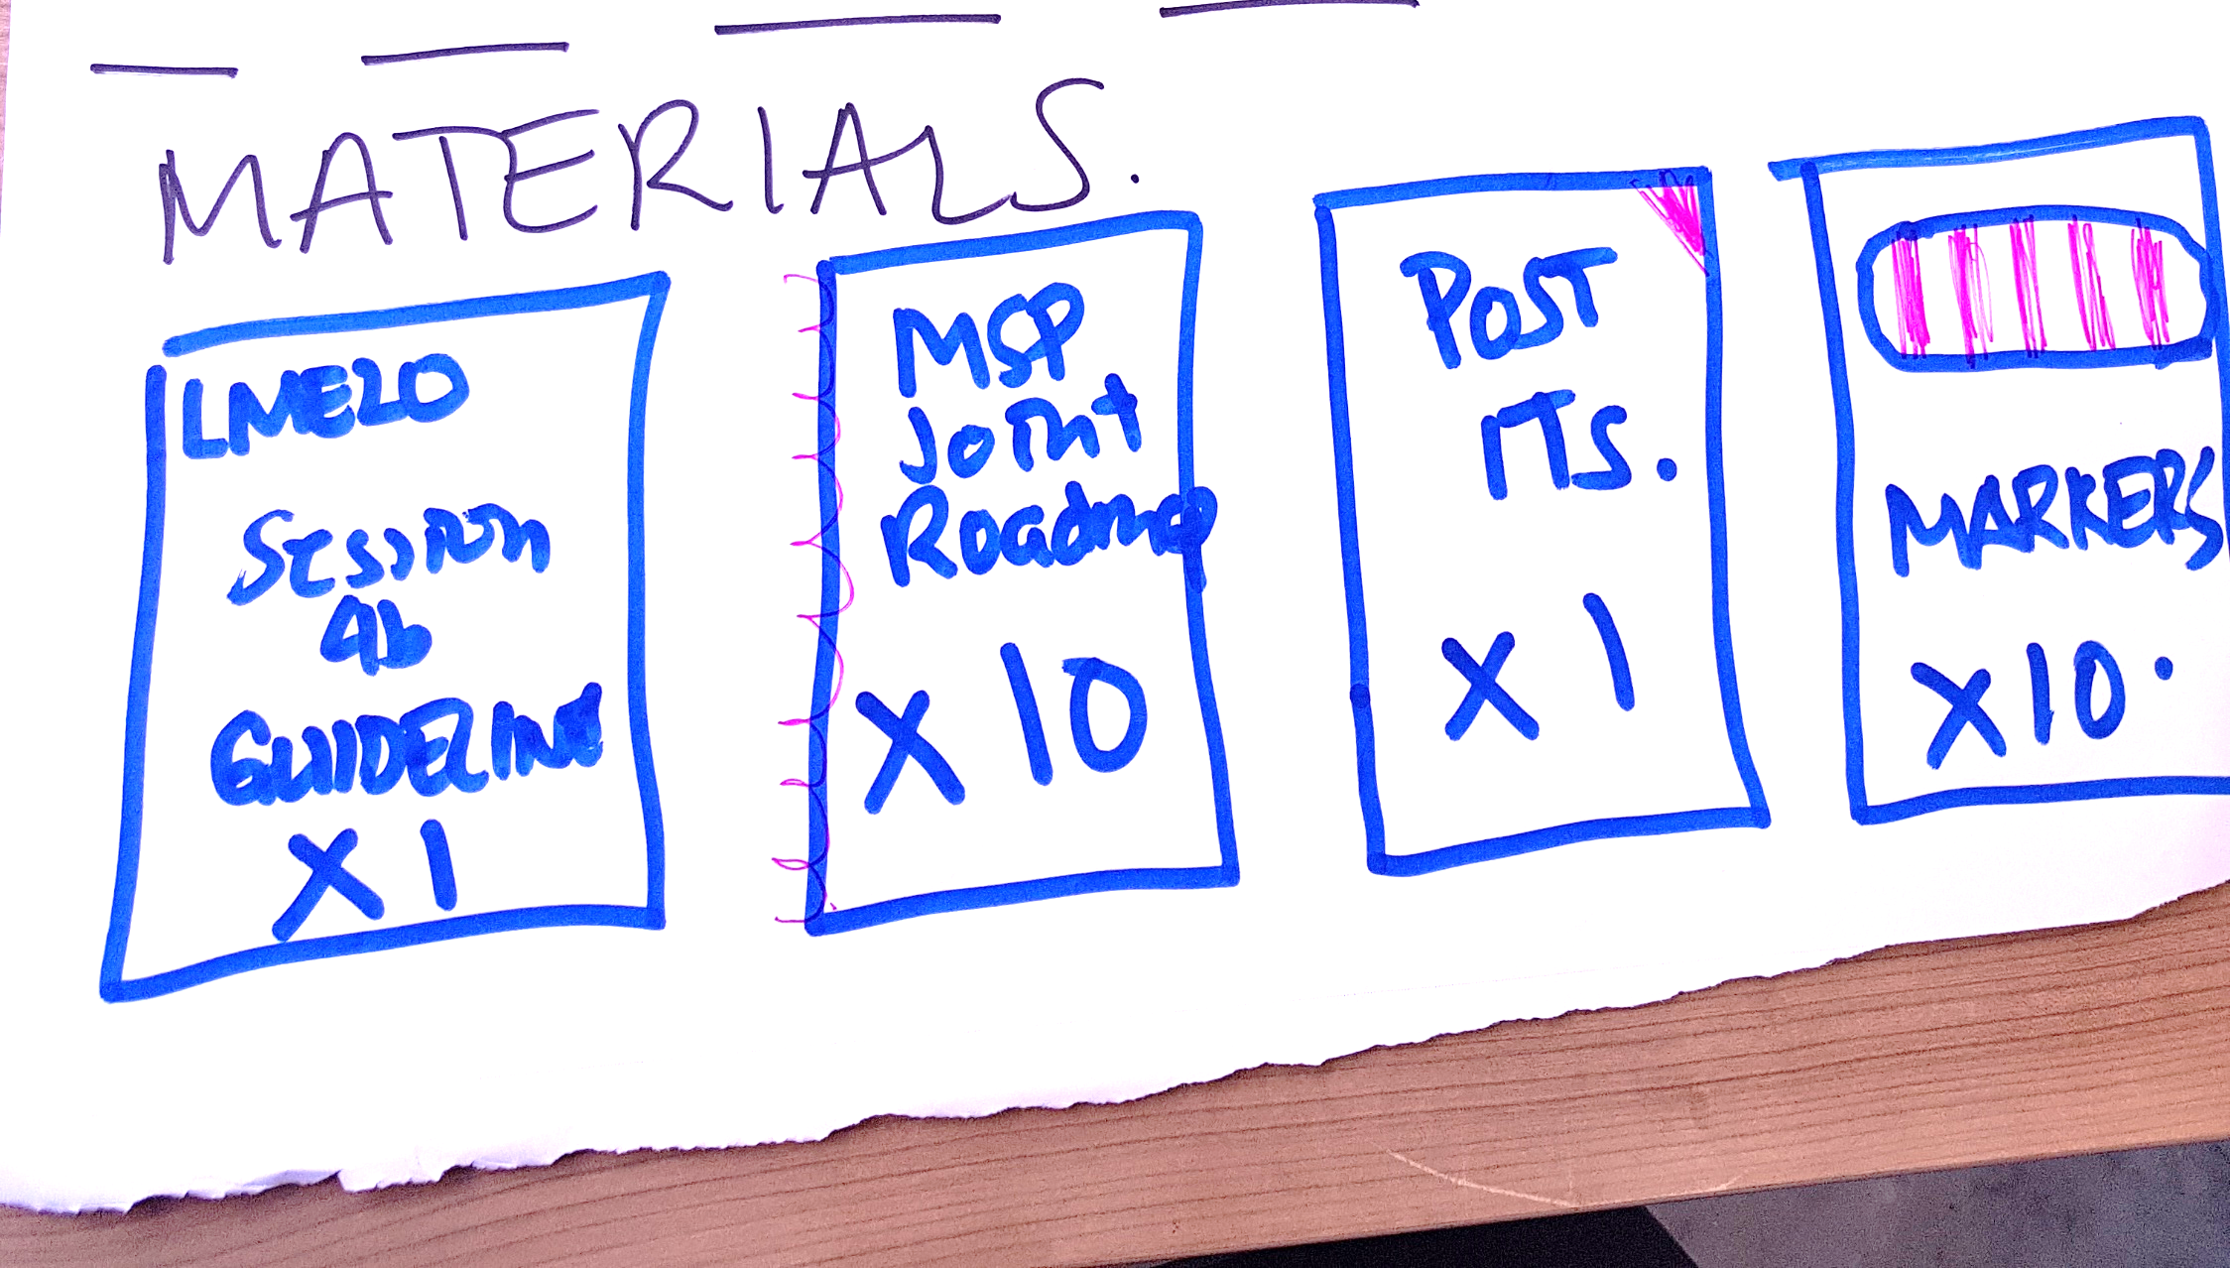

Slide 4


Slide 5
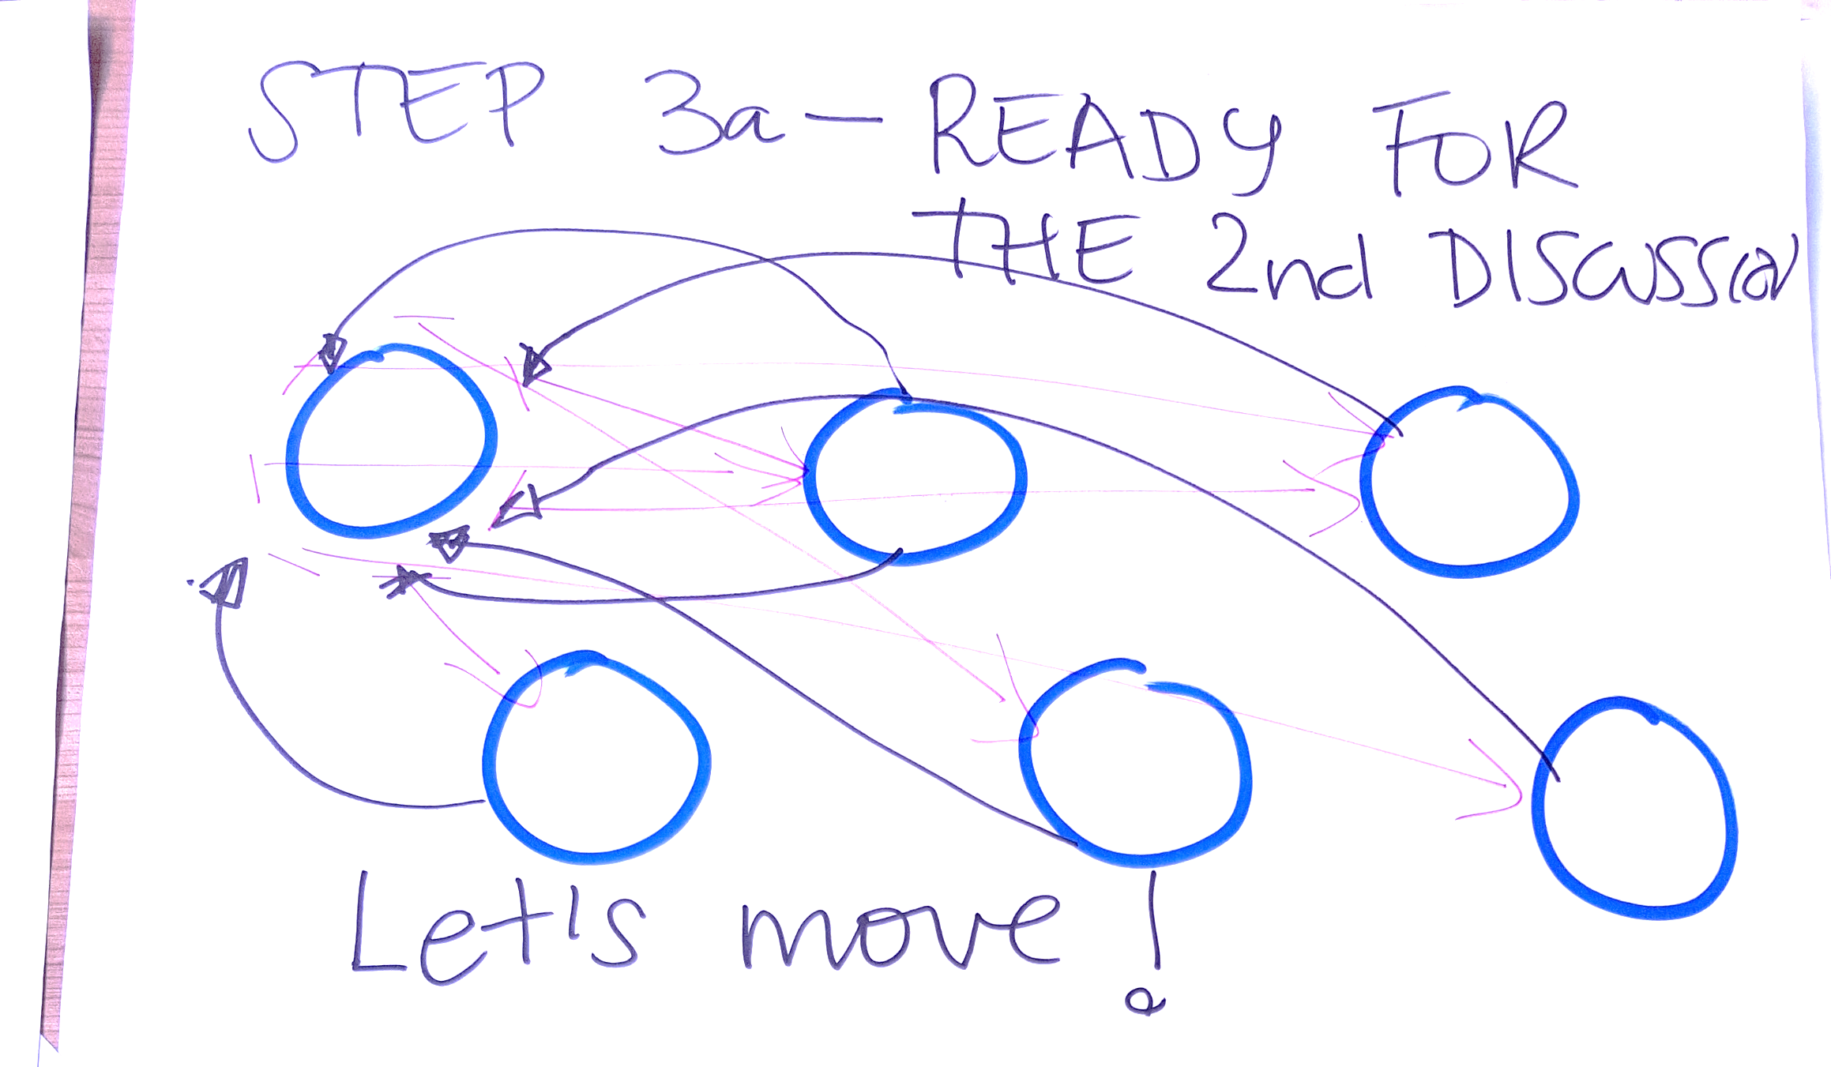

Slide 6
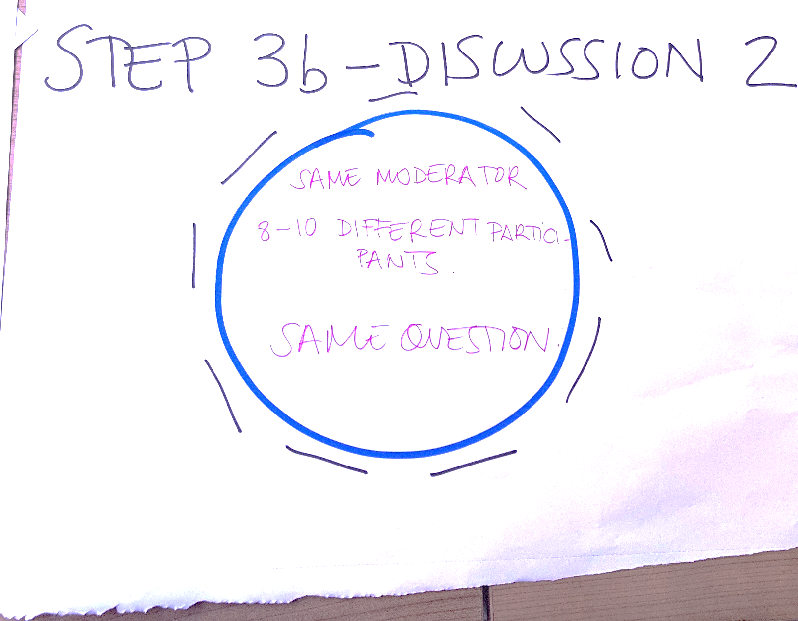

Slide 7
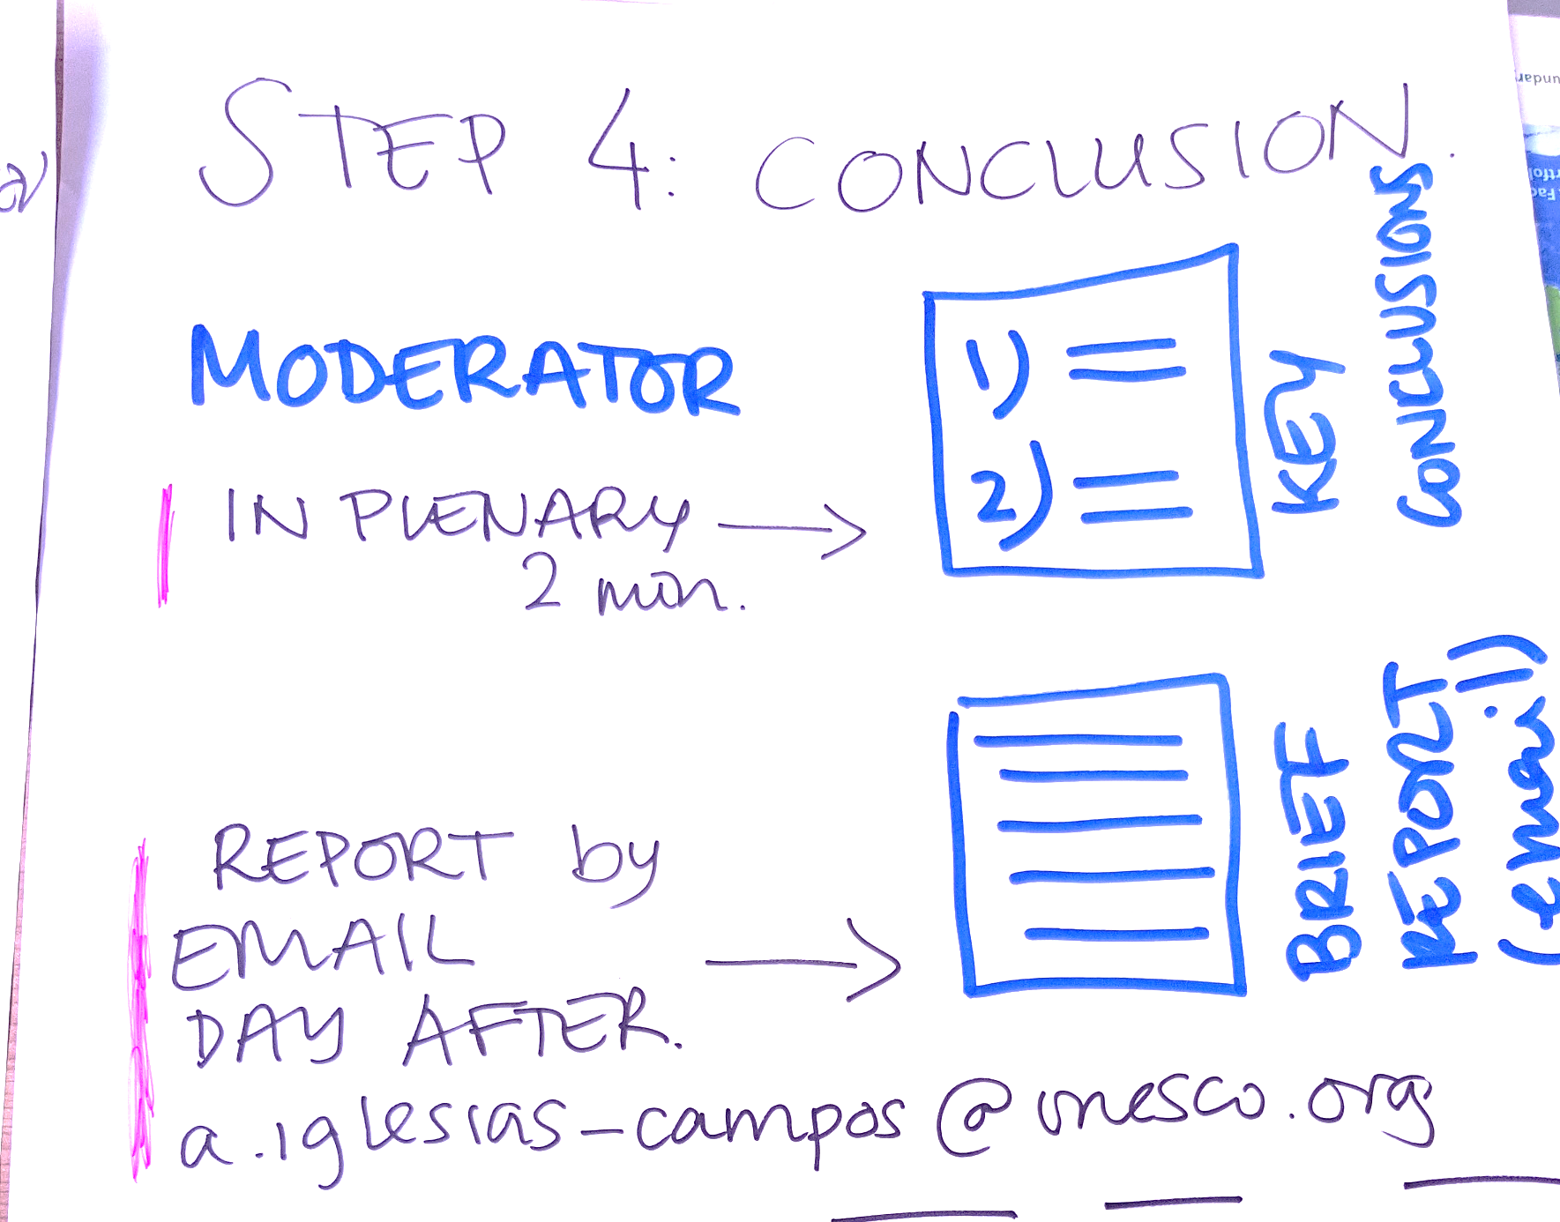

Slide 8
Table 1

Slide 9
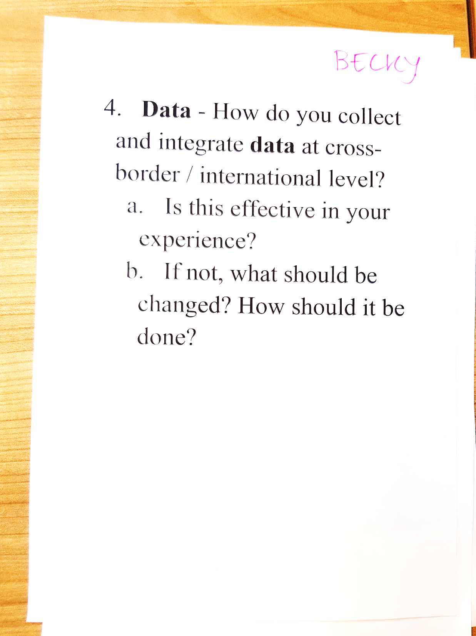

Slide 10
Table 2

Slide 11
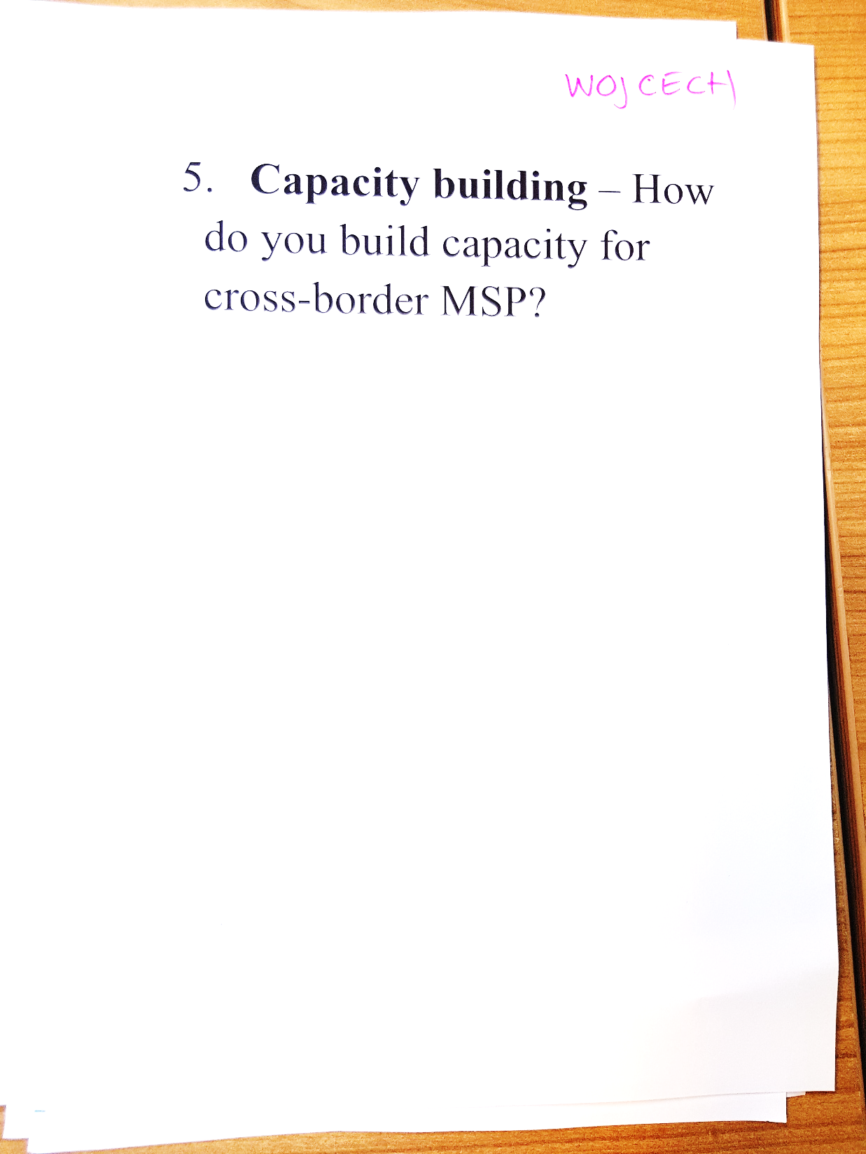

Slide 12
Table 3

Slide 13
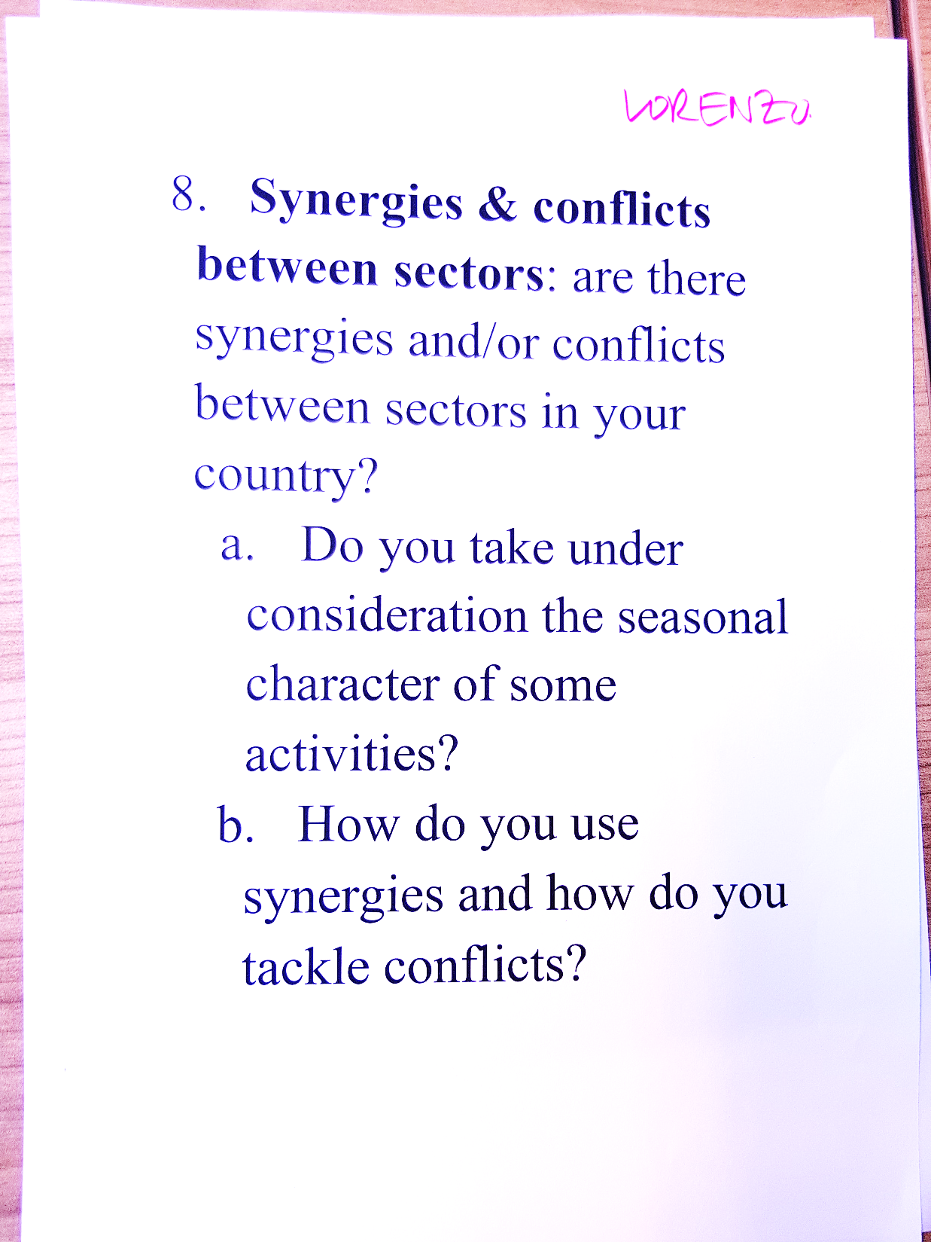

Slide 14
Table 4

Slide 15
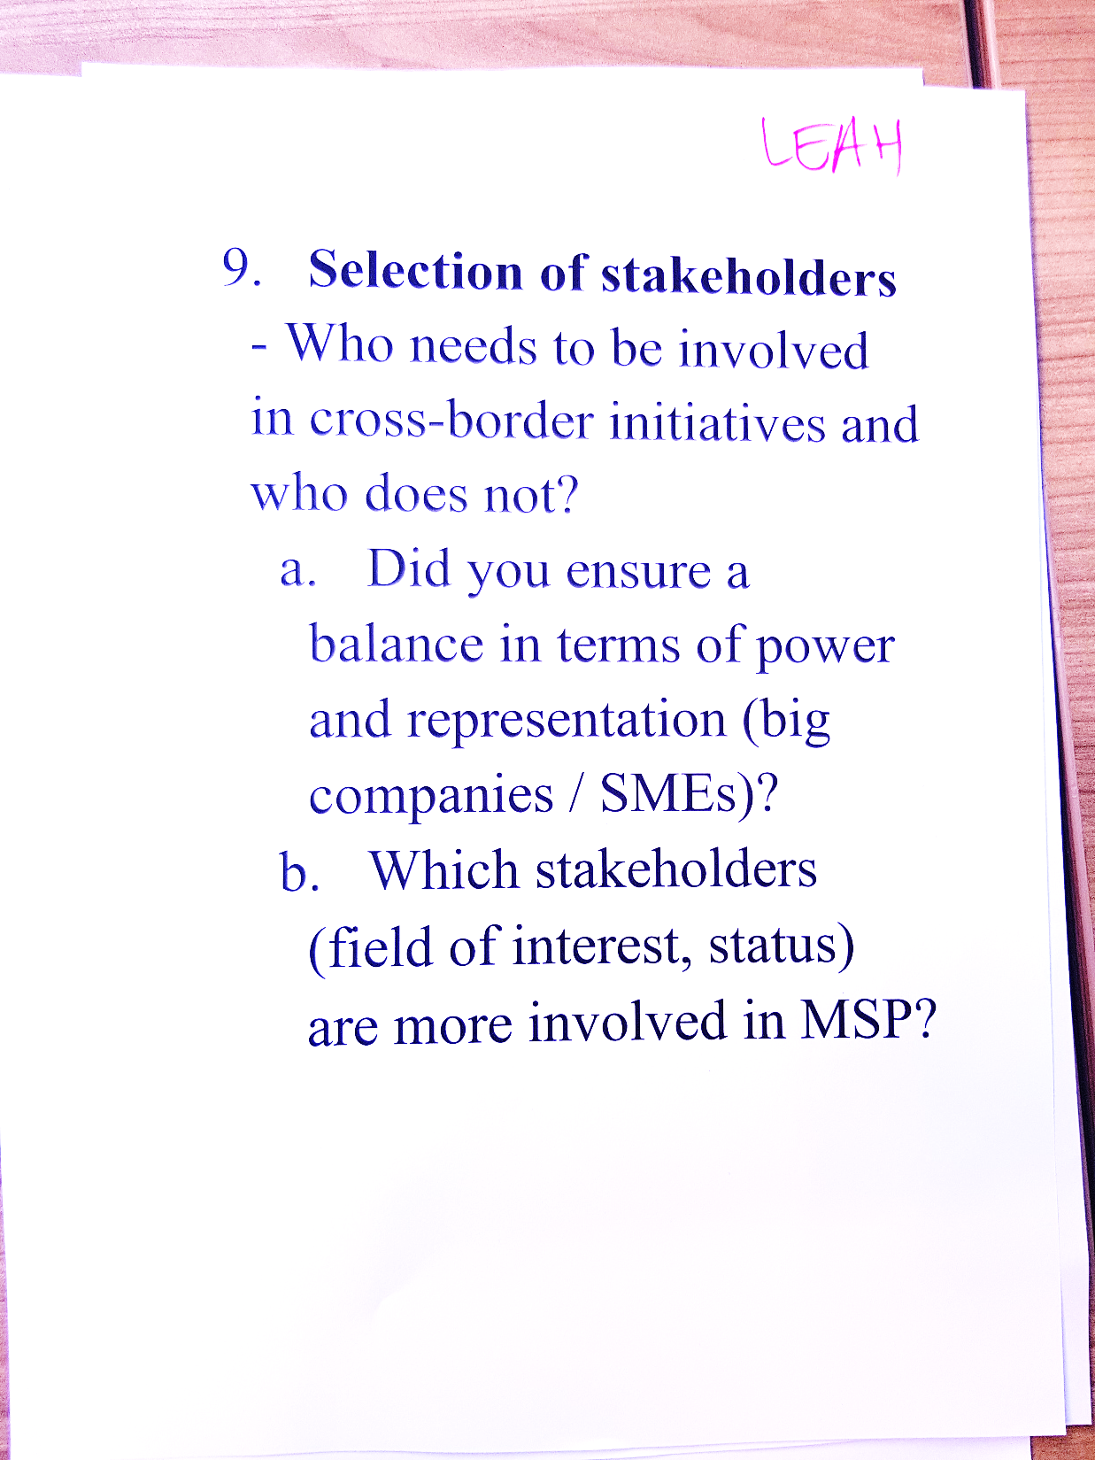

Slide 16
Table 5

Slide 17
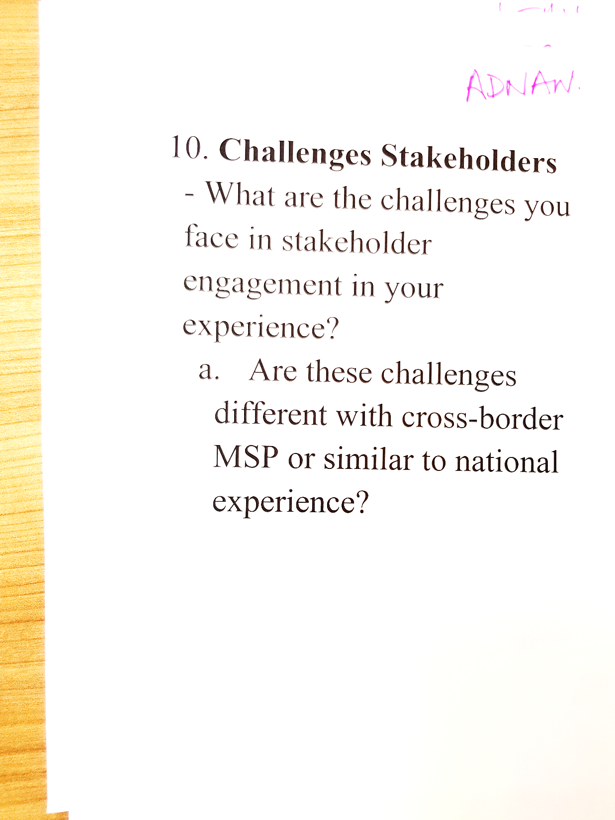

Slide 18
Table 6

Slide 19
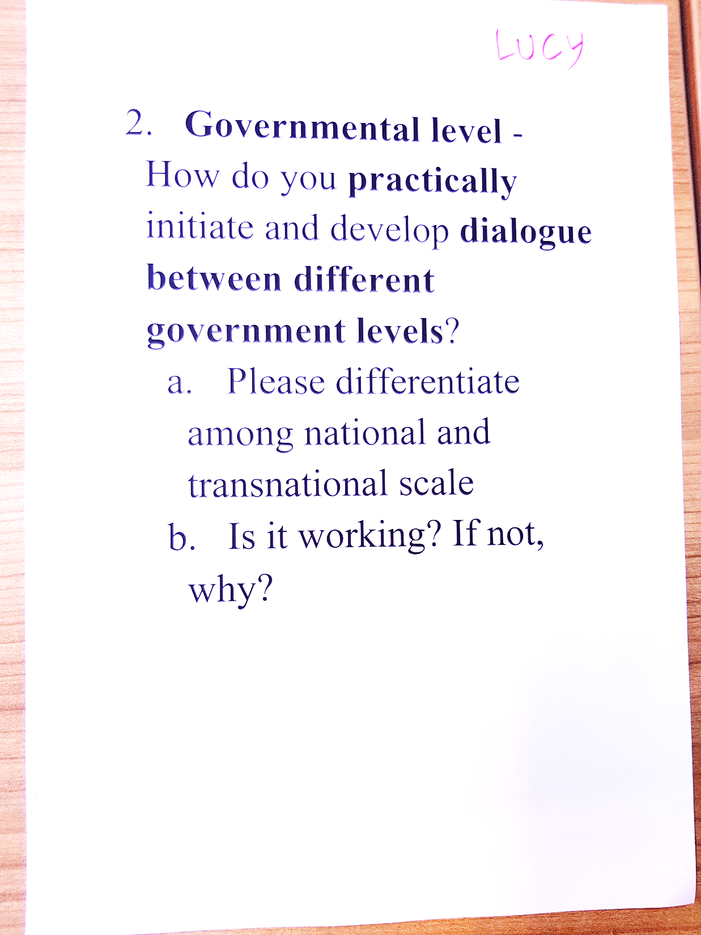

Slide 20
Table 7

Slide 21
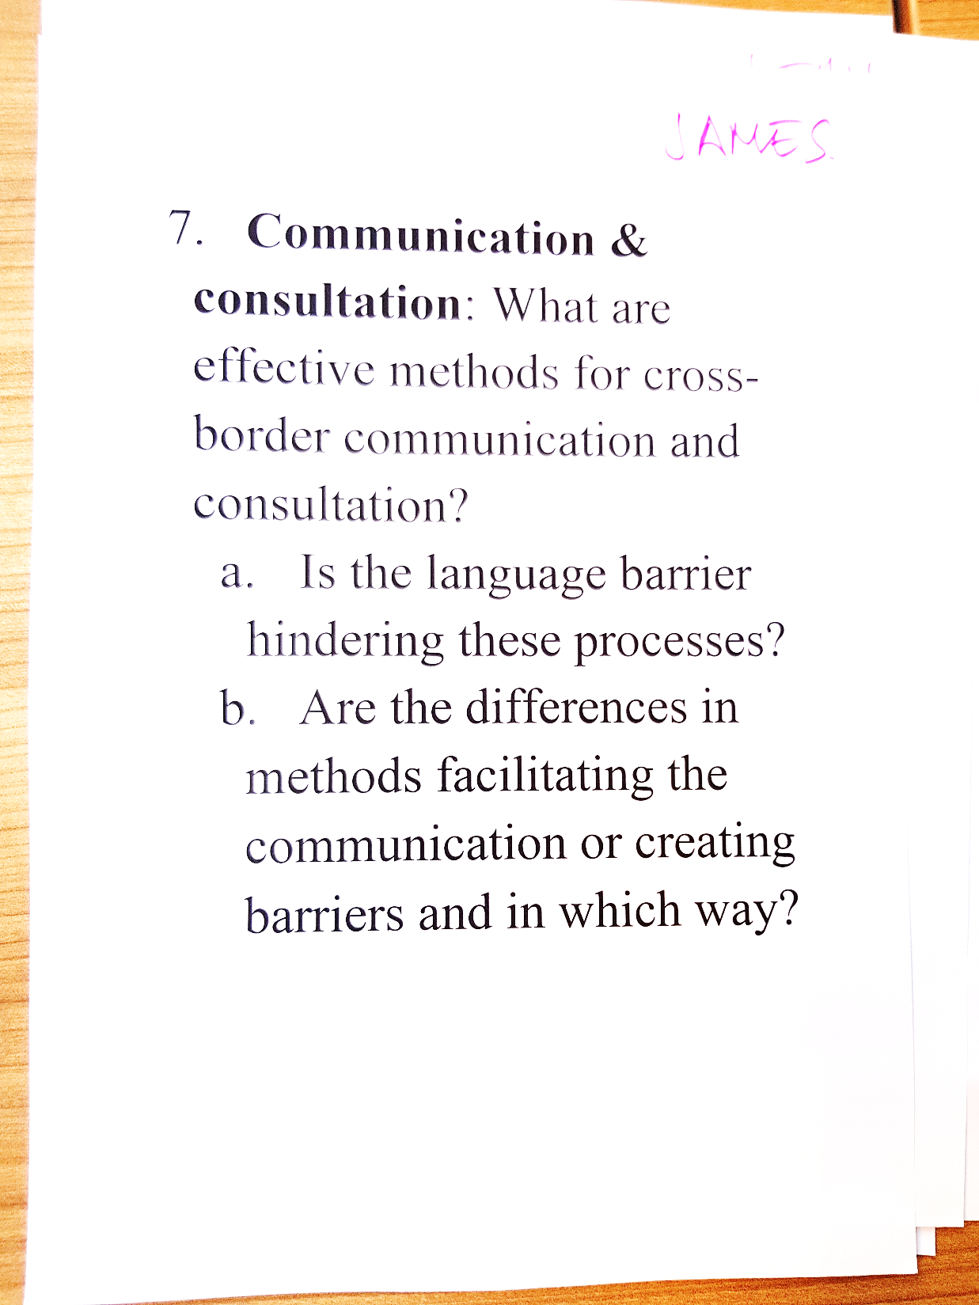

Slide 22



Stronger together
شُكْرًا
ⵜⴰⵏⵎⵎⵉⵔⵜ
¡Muchas gracias!
Merci!
Thank you!
Спасибо
谢谢
http://msp.ioc-unesco.org
Notes:
22
We will be stronger, if we do it together

